Slide 1

Plain Flaps vs Slotted Flaps
Brandon Henry

Slide 2
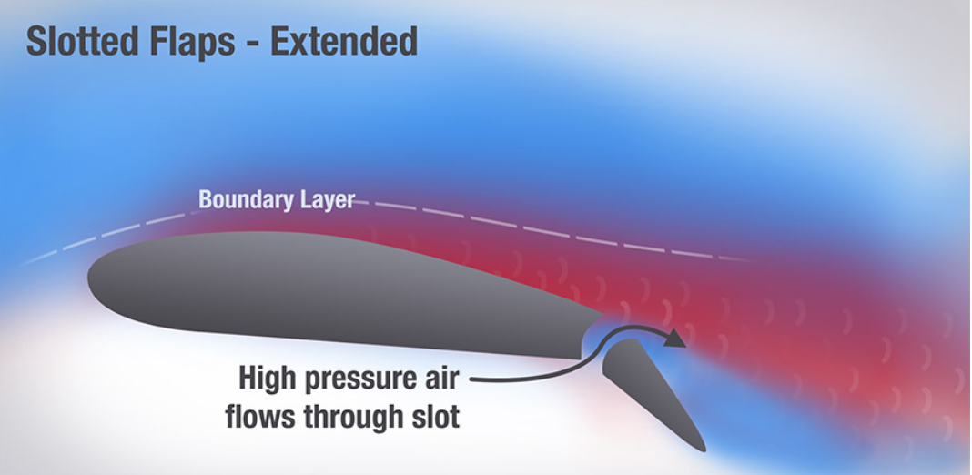
Background
Slotted flaps are an option for the plane, because this design allows high air pressure to flow through the slot, which adds "energy to the wing's boundary layer, delays airflow separation, and produces less drag"

Slide 3
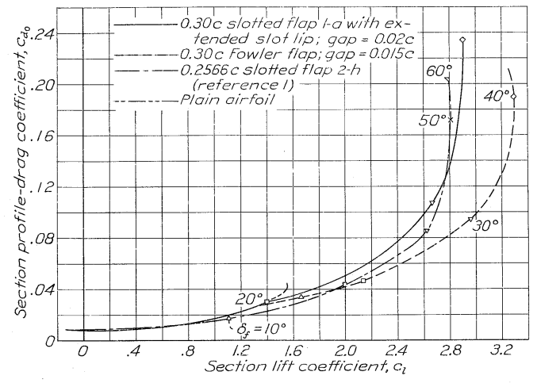
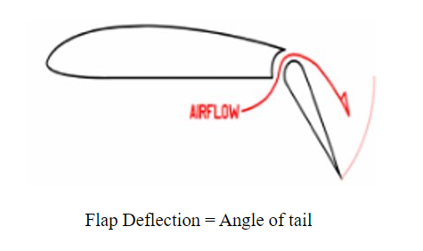
Comparisons (Plain vs. Slotted)
The Plain Flaps produce a higher drag compared to the slotted flaps at a shallower angle of deflection, while also producing left lift

Slide 4
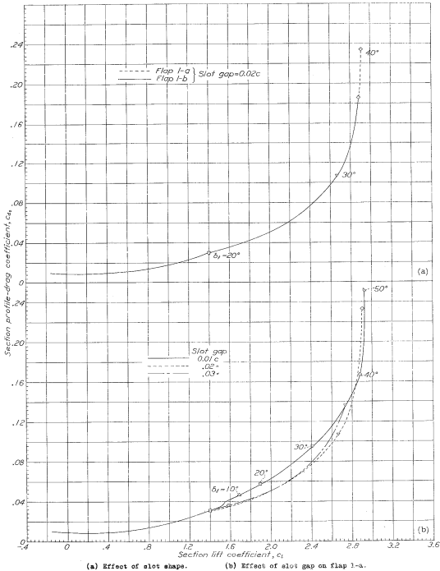
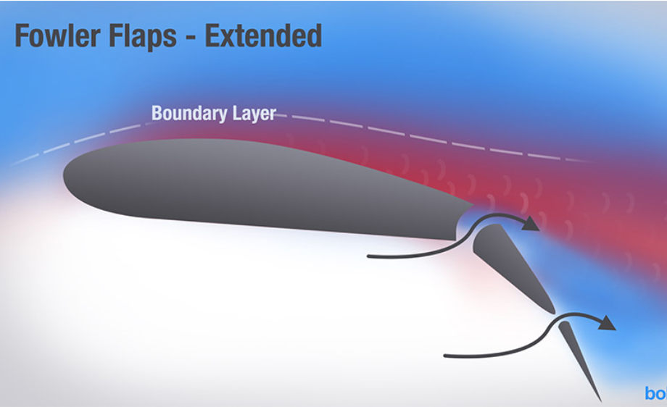
Types of Slotted Flaps
Slots can vary based on the spacing between the slots. The difference the between the spacing of the slots is nominal/insignificant. There is another variation of slotted flaps called "Fowler Flaps" which add another slot further down on the airfoil

Slide 5
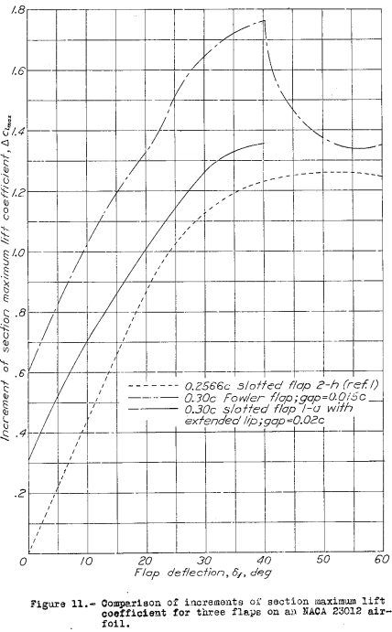
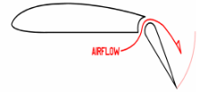
Comparisons (Fowler vs. Slotted)
The Fowler Flap produces the most lift with the shallowest Flap deflection
Flap Deflection = Angle of tail

Slide 6
Conclusions
In order of best performance we should consider:
Fowler Flaps specifically for its best lift to drag ratio
Slotted Flaps are still a great runner-up option they just don't perform as well as Fowlers
Plain Flap is still a reliable option for flap design, it just will not excel in producing lift compared to the other options

Slide 7
References
https://www.boldmethod.com/learn-to-fly/aircraft-systems/how-the-4-types-of-aircraft-flaps-work/
https://ntrs.nasa.gov/citations/19930085051
https://www.timetravelair.com/techlibrary/FANASA%20-%20Comparison%20of%20Aerodynamic%20Characteristics%20of%20Double%20Slotted%20and%20Single%20Slotted%20Inverting%20Flaps.pdf
https://www.researchgate.net/publication/347523406_Influence_of_a_slotted_flap_gap_size_on_the_aerodynamic_characteristics_of_a_light_aircraft_wing_at_taking_off_and_landing

Slide 8
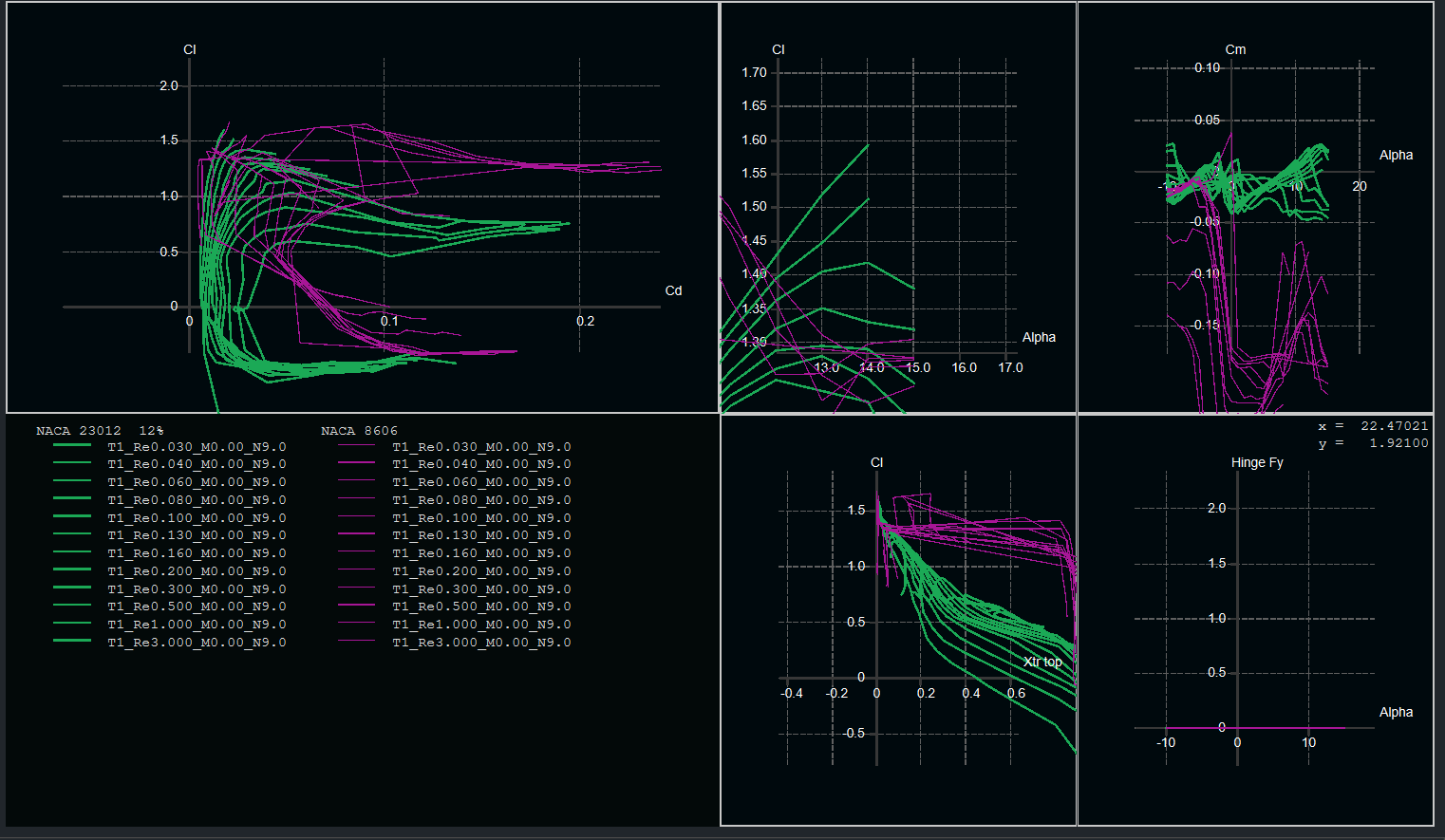
XFLR5 Foil Comparisons
NACA 23012 is a slotted flap airfoil (color)
NACA 8606 is a plain flap airfoil (color)

